Slide 1


BCCPA 2015 conference
Using innovative techniques to make a $6/day
food allowance into nutritional & tasty meals:
Panel presentation
Robert Cunningham – Sysco Regional Business
Development Manager, Healthcare
Nazma Khan – Head Cook at Dufferin Care Centre
Retirement Concepts
Suzanne Quiring – Registered Dietitian
SuzyQ Menu Concepts

Slide 2

Food for YOUR New Resident
PRESENTER:
Robert Cunningham
Sysco Canada

Slide 3

Agenda
Planning Your Menu
Costing/Menu Development
Sourcing
Events

Slide 4
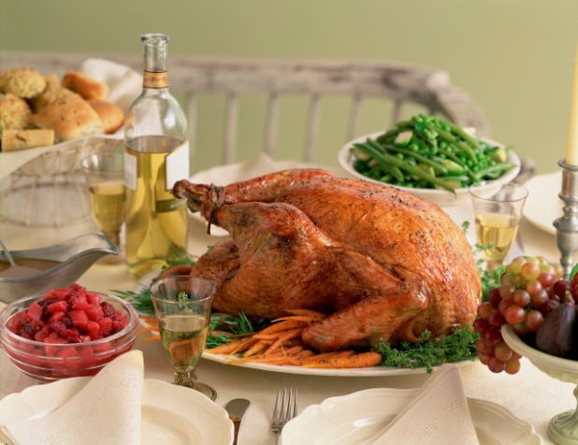
Planning your Menu
Canadian Food Guide
Products
Demographics - Today & Future
Technology, Social Media
Local, Sustainable Focus

Slide 5
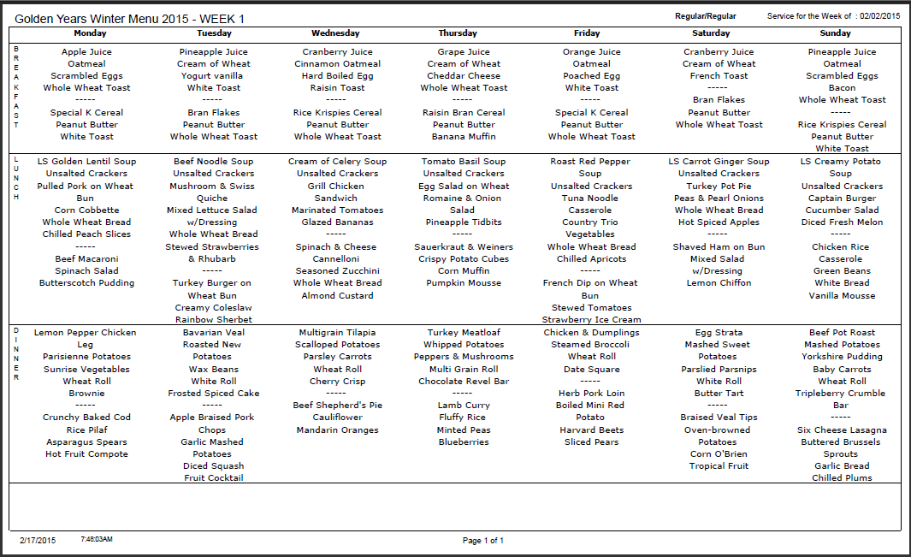
Menu Sample

Slide 6

costing/Menu Development
Kitchen Staff
Dining Room Staff
Distributor
Resident and Family
Menu Services

Slide 7

Sourcing
Who? What? When? Where? Why?

Slide 8

Events………..
Where the Rubber meets the Road- Where Mission Vision Values take LIFE
How Many?
Why?
Wine Pairing?
Increased Cost?

Slide 9

Next Steps??????
Now What?

Slide 10
How to Keep Foods Costs
Below $6 Per Resident
Presented by Nazma Khan
Head Cook Dufferin Care Centre
Notes:
Good Afternoon Everyone, My Name is Nazma Khan and I am the Head Cook at Retirement Concepts Dufferin Care Centre in Coquitlam
I’ve worked at DCC for the last 13 years. I have had a few positions in the kitchen which has helped me understand texture modified diets.
I love working at DCC, it is my home away from home.
I love my Leadership Team which have been great to me.
I love my residents who always have a smile for me.
And … I love to make their day by preparing and serving great food!
I was asked to speak on how to keep food costs below $6 per resident.

Slide 11
Methods to Control Food Costs
Portion Control – Waste Management
  Follow Established Menus & Recipes
  SuzyQ Dining Service
  Purchasing Cost Controls - Scratch vs Ready-To-Use
Food Preparation – In House Texture Modified Diets
  Pureed Breakfast
  Lunch, Dinner, Desserts & Drinks
Notes:
Today, I will be discussing a few methods to control food costs
#1 is Portion Controls and Waste Management
Also, We need to follow an established menu & recipes
At DCC We use the SuzyQ Dining Service method
And purchasing cost controls such as
Scratch vs Ready-To-Use
The main topic of my presentation will focus on
In-House Texture Modified Diets for all meals

Slide 12
Portion Control – Waste Management
Dining Service
  Follow established menu & standardized recipes
  Use SuzyQ cart in dining room so residents can choose foods and portion sizes
  Purchasing Cost Controls
    Don’t over produce in the kitchen
    Count portions
Notes:
When talking about portion control & waste management we need to following established menu & standardized recipes ensures quality control as well as cost controls.
Only food listed should be ordered and used in recipes, all substitutions must be documented.
It’s easier to follow up on our food costs.
We use Susie Q cart in the dining room so its easier to ask the resident what they want and how much.
Staff interact with residents & find out what food they like and don’t like
Menus can be changed so we are serving the food residents like – so there is less waste
That helps us control waste by knowing the portion size.
We don’t overproduce food in the kitchen – there should only be about 5% or less leftover food at the end of meal service.
We need to Count portions - consider large and small portions, dislikes, allergies and alternates

Slide 13
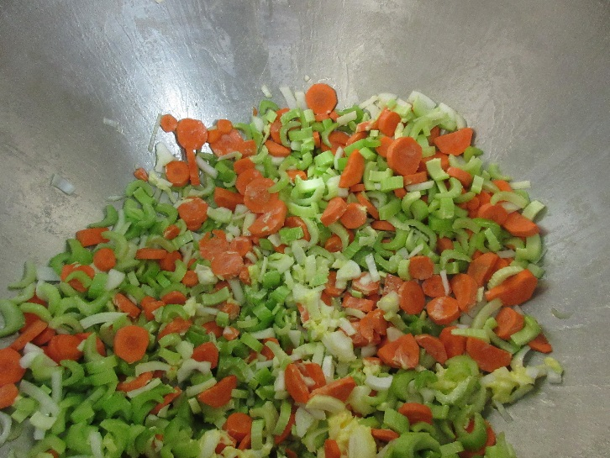
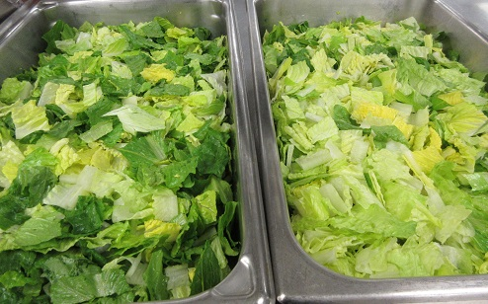
Purchasing - Cost Controls
Scratch vs Ready-To-Use
  Making from Scratch is Labour Intensive – Expensive?
  Ready-To-Use is more expensive to purchase but has less labour
Notes:
There are many purchasing cost controls but I am only going to mention
Scratch vs Ready to Use
The point is that making food from scratch is cheaper to purchase but requires more labour to produce it.
Labour is Expensive!
At Dufferin we do both but our main cost savings comes from making our own texture modified diets.

Slide 14
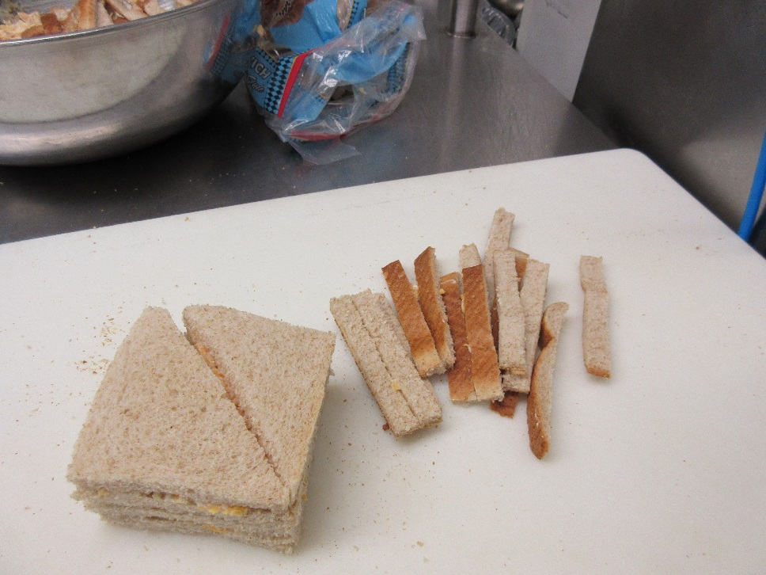
  The challenge is to provide nutritious food for all texture modifications
Notes:
The Challenge is to provide
nutritious food
for all texture modified diets.
At DCC we have 153 residents
But only 15 regular diets
all the rest are texture modified diets,
cut up, mince and puree.
About 50% of our residents are minced & pureed
So you can see how important it is to make your own texture modified diets to help YOU save money.

Slide 15
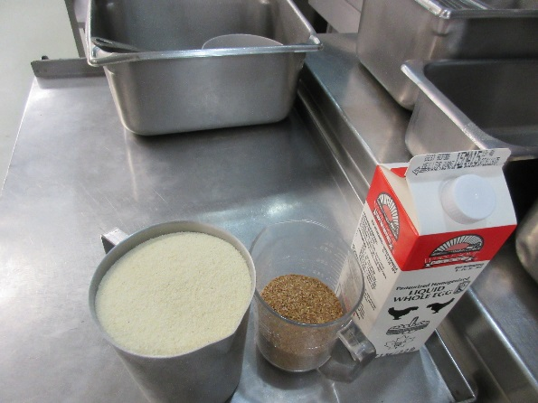
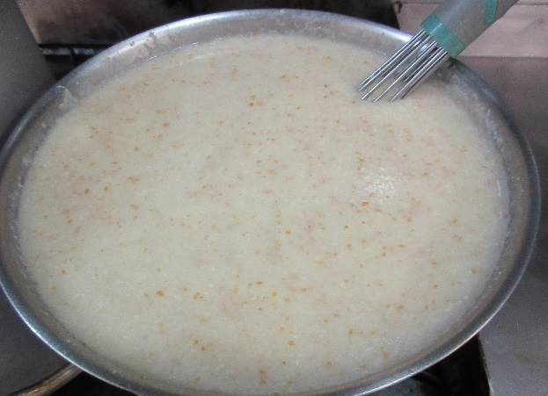
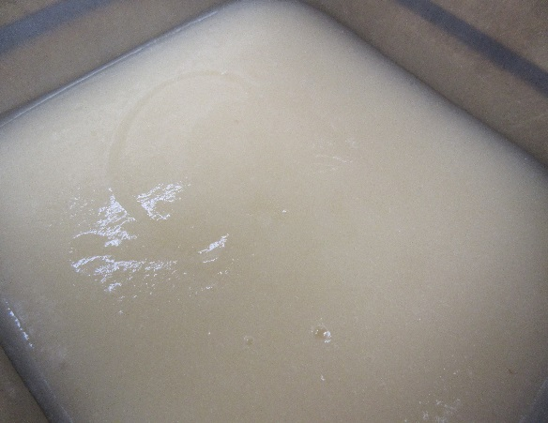
Food Preparation–Pureed Breakfast Bowl
Pureed Fortified Hot Cereal & Pureed Pears (Fruit)
Cream of Wheat, Natural Bran, Liquid Egg with Pureed Fruit, Brown Sugar & Milk added at point of service
Notes:
For our Pureed Breakfast Bowl we make our own Fortified Hot Cereal
We use Cream of Wheat, add natural wheat bran and liquid egg
For Pureed Fruit we use can fruit with the juice and a starch based thickener.
In the dining room we add the fruit, brown sugar & milk to the hot cereal
This is a complete nutritious breakfast for a very low cost!

Slide 16
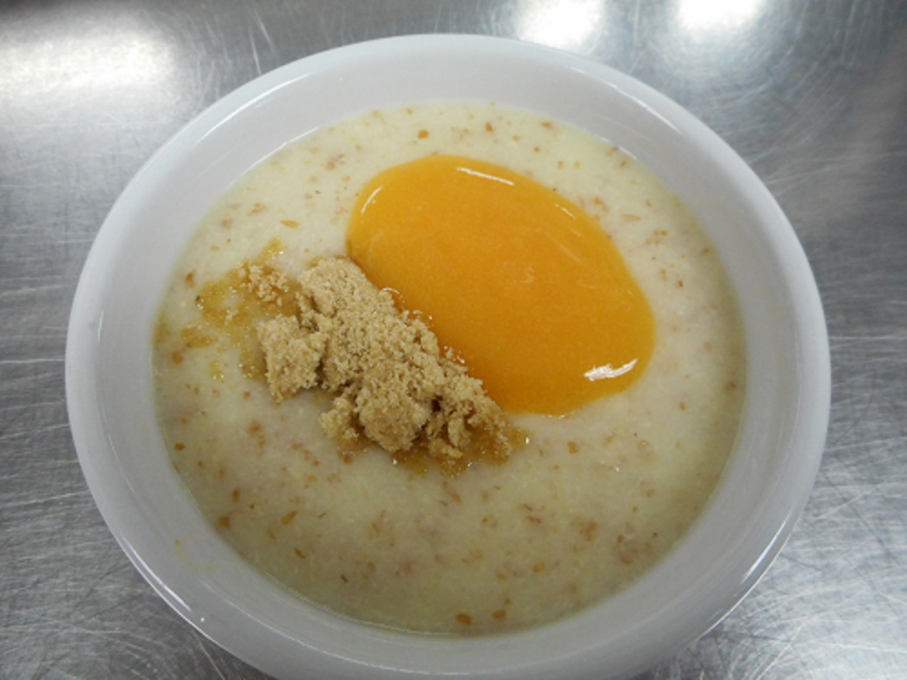
Pureed Fortified Breakfast Bowl
Notes:
Ladies and Gentleman
I would like to present to you, My Famous Breakfast Bowl!

Slide 17
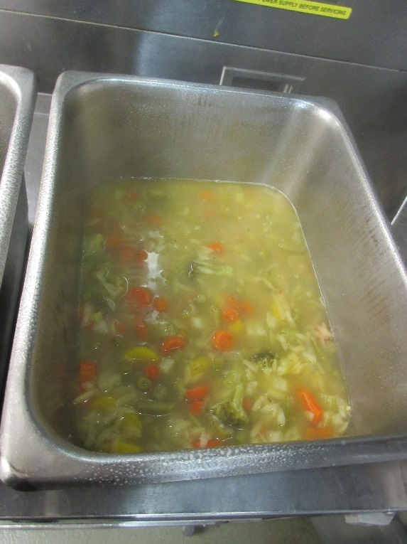
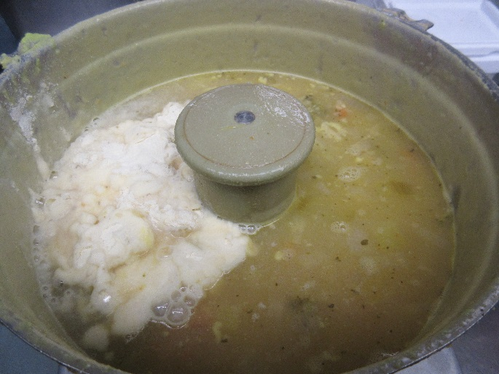
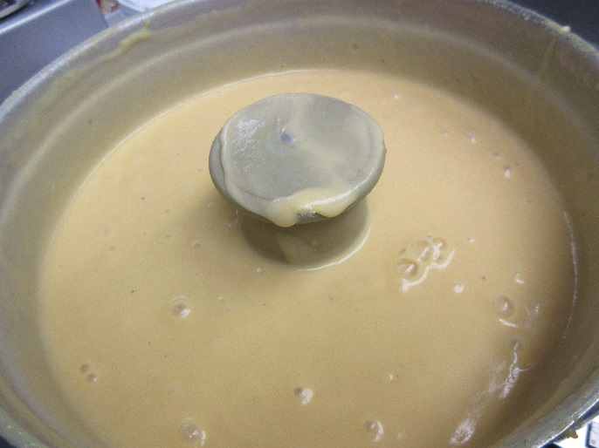
Food Preparation - Lunch
Pureed Chunky Vegetable Orzo Soup – regular soup + instant potatoes
Notes:
For my lunch, we have soup, sandwich and salad. I make all my soups from scratch which is a huge cost savings.
For our Minced and Pureed soups we make in-house using instant mashed potatoes or left over potatoes, instead of using commercial thickener (which is expensive)
Potatoes help to increase nutritional values as well as save money.

Slide 18
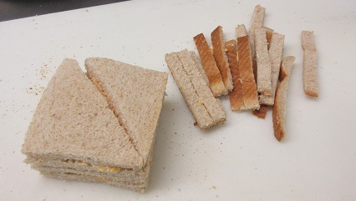
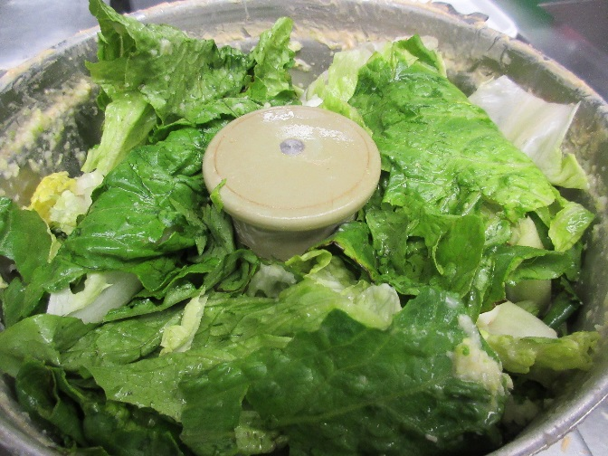
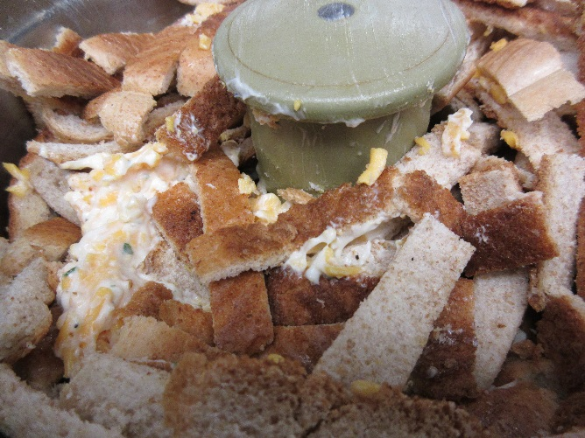
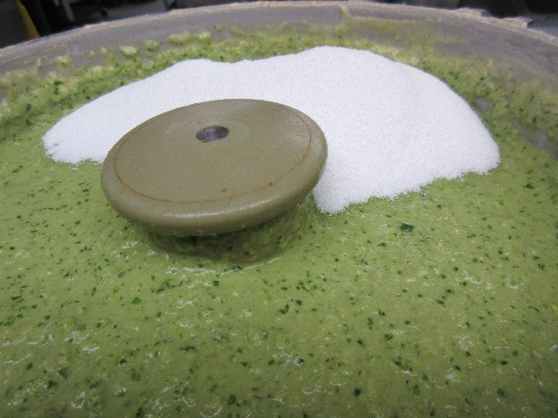
Food Preparation - Lunch
Minced Diet-Crustless Cheese Sandwich, Pureed Sandwich & Salad
Notes:
For our regular sandwiches we slice all our meat in-house
We mince our own meat and make mince sandwiches and use the cut off crusts for our puree sandwiches.
The purees are blending in the robot coupe to the right texture and added crusts, helps thicken it.
We make our own salads and we use the trimmings from the salad prep to mince and puree the salad in the robot coupe with starch based thickener to get the right texture.

Slide 19
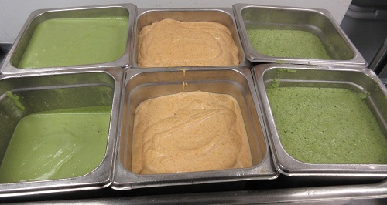
Food Preparation - Lunch
Minced & Pureed Cheese Sandwich and Caesar Salad
Notes:
Here it is Ladies and Gentleman.
My mince and pureed salad and cheese sandwiches.
It looks good, It tastes good, It is cheaper to make.
And is excellent quality

Slide 20
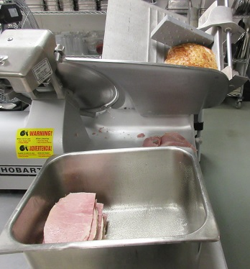
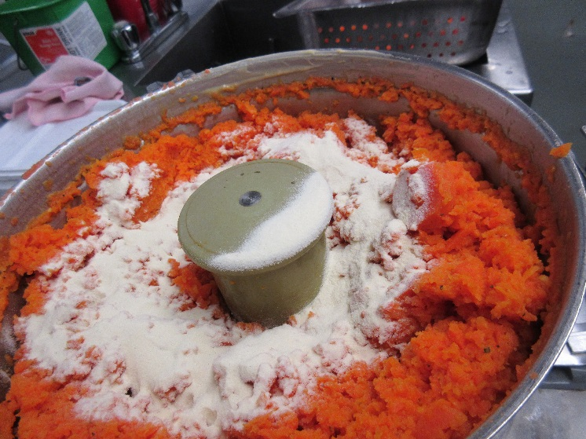
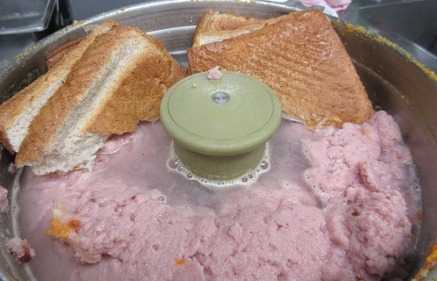
Food Preparation - Dinner
Pineapple Glazed Ham, Mashed Potatoes, Carrots
Notes:
For our dinner menu we have pineapple glazed ham, mashed potatoes and carrots
We slice, cut up, mince and puree our own ham. I add bread crust to thicken pureed ham
For my pureed vegetable , I use instant potato to thicken to get the right texture.
Potatoes and bread help keep our food costs down instead of using commercial based thickener.

Slide 21
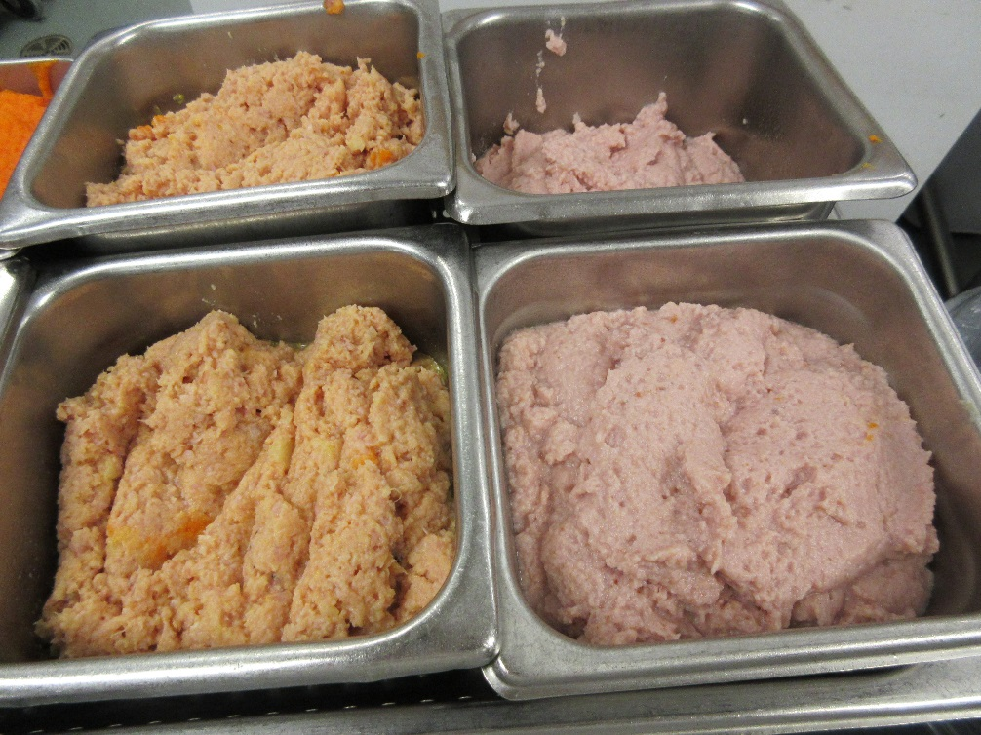
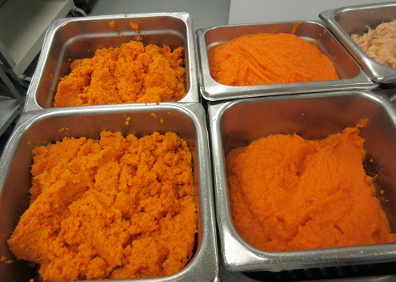
Food Preparation - Dinner
Minced & Pureed Final Product
Notes:
Voila … Here is my
mince and puree
dinner meal

Slide 22
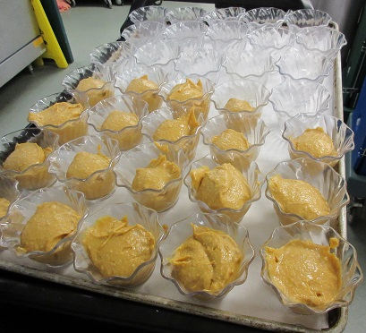
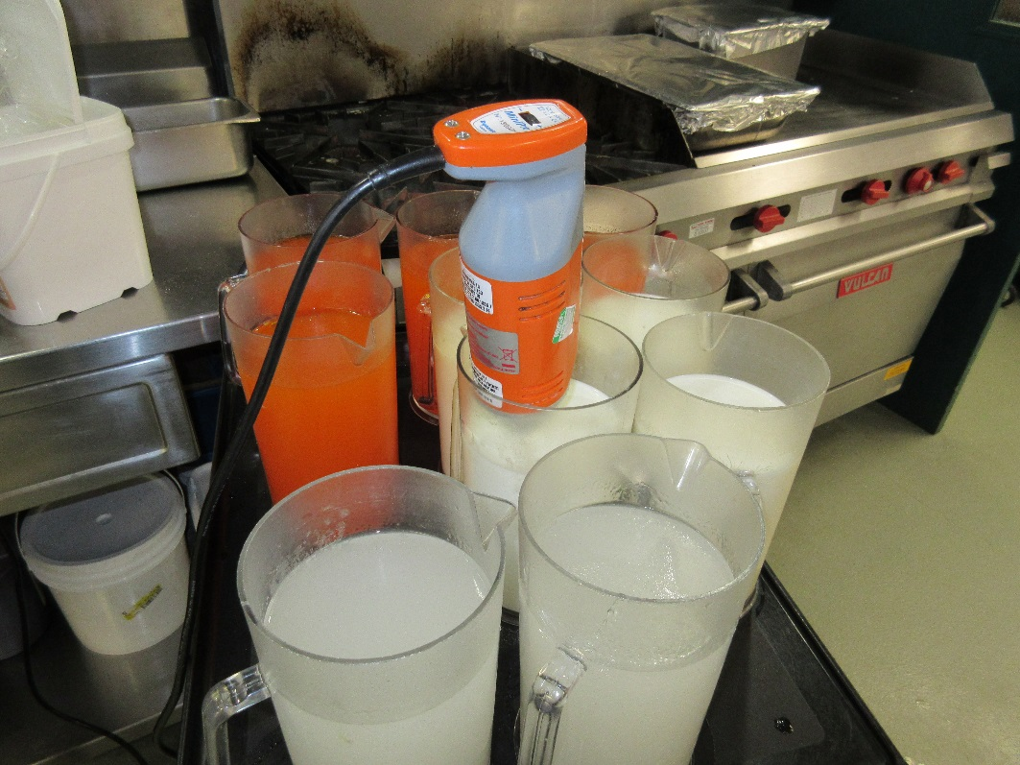
Food Preparation – Desserts & Drinks
Minced & Pureed Pumpkin Pie, Honey Thick Juice
Notes:
For our drinks we do purchase some ready to use thickened juice and make our own thick milk, water and diet juice.
We puree & mince our regular desserts so everybody gets the same thing.
We always follow our menus and recipes for all our texture modified diets so everyone gets good quality food.
At DCC we are proud to serve excellent food AND stay within of budget to keep our food costs under $6 per resident per day.

Slide 23

Improving the Dining Experience
(while stretching the $6/day)
by
Suzanne Quiring, Registered Dietitian
SuzyQ Menu Concepts
www.hotfoodcart.com

Slide 24

Ask yourself... (and family, residents, staff)
1)What aspects do you value when dining?
2) What is great & what frustrates you with
your site’s current meal service?
(name it, claim it, know it, to work on it)
3)At your site, what is getting in the way of having a “WOW” dining experience?

Slide 25

Of a 1-10 rating of a “Great Dining Experience”...
~5.4 average score
(n = 500)
Lack of choice Lack of resident involvement
Cold food High food preferences
Budget restrictions Timing of meals
High noise level Poor teamwork = departments
Staff break times Presentation of food boring
Trays! Institutional High food waste
As an industry we have work to do
Working hard but…is there room for improvement? Different and better way?

Slide 26




Top 5 Challenges for LTC
Cold food
High food wastage = $$
Lack of choice
Poor “customer service” to residents
Updating the “likes/dislike” lists

Slide 27
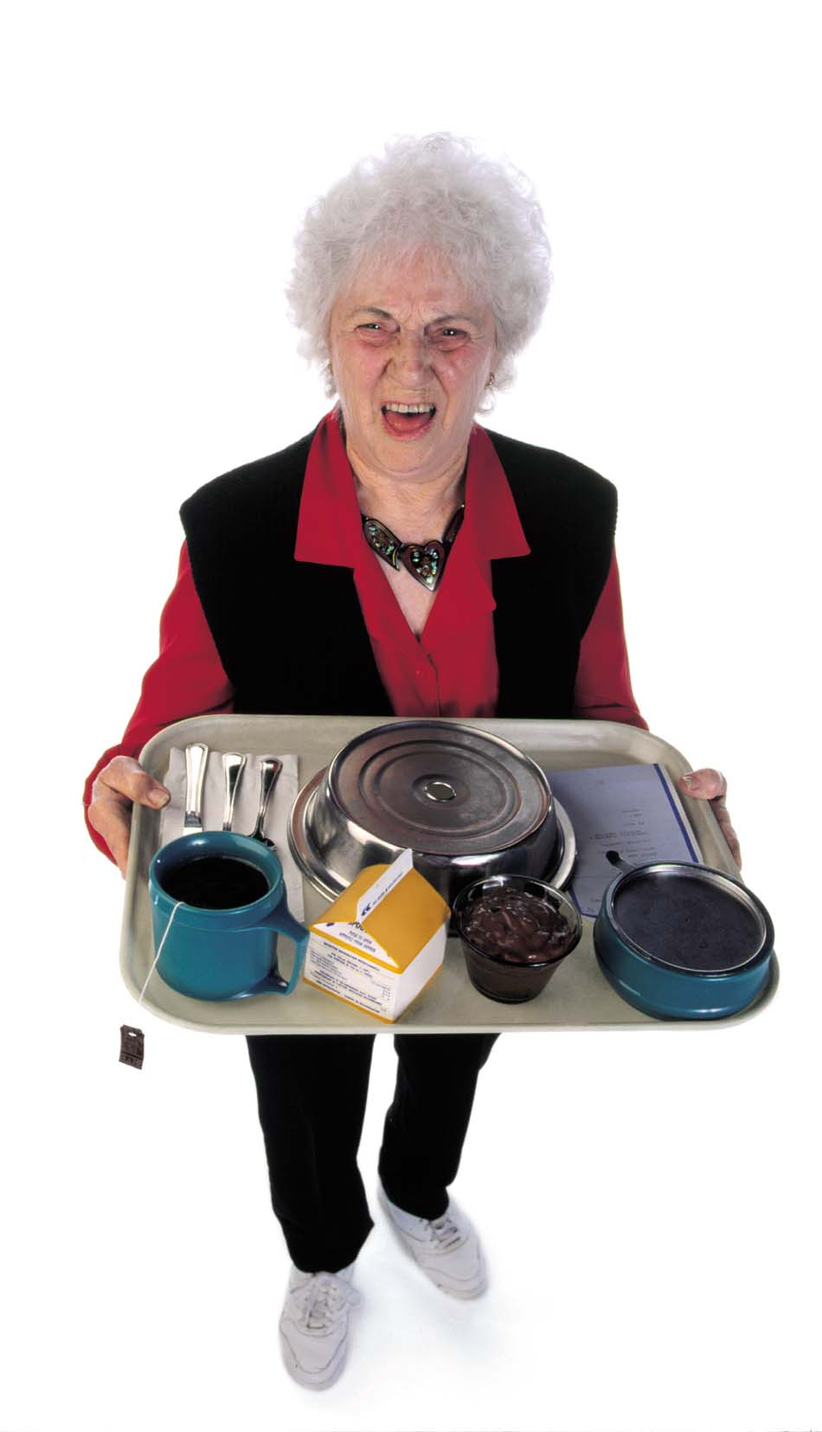
The
“Dining Experience”
When asked…
what is important to residents?

Slide 28
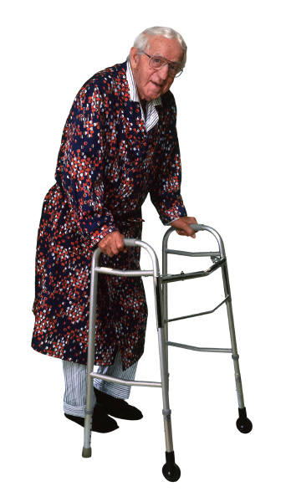
Resident’s Top 5 Needs
Choice!
Proper temperature & size
Show me dignity and respect by communicating with me
Talk to me even if you think I am “confused”
Listen and consider feedback

Slide 29

“ How” we provide great service in our LTC dining rooms is key for resident-focused care while saving money!
My experience → needs some examination & vision!
It’s a TEAM effort with support from upper management

Slide 30

  “Common Practice”
  vs
  “Best Practice”
(what does the research say?)

Slide 31

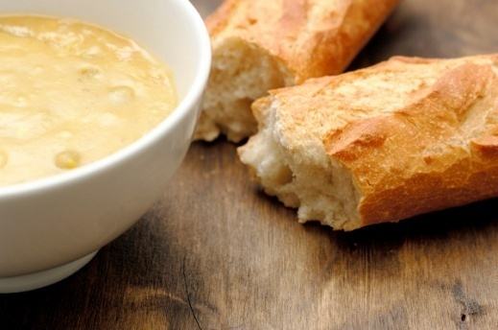
#1) Tray service System
150 bed Long Term Care facility
3 separate dining rooms
Menu
Split Pea Soup
Ham and Cheese Sandwich
Ice cream

Slide 32
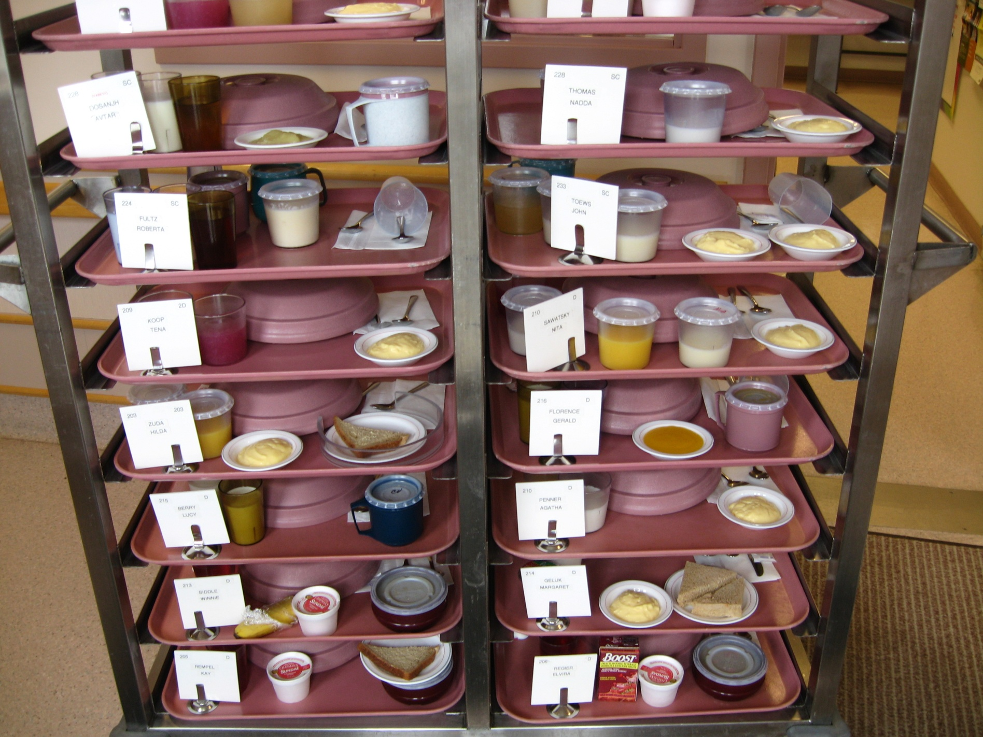
Before…

Slide 33
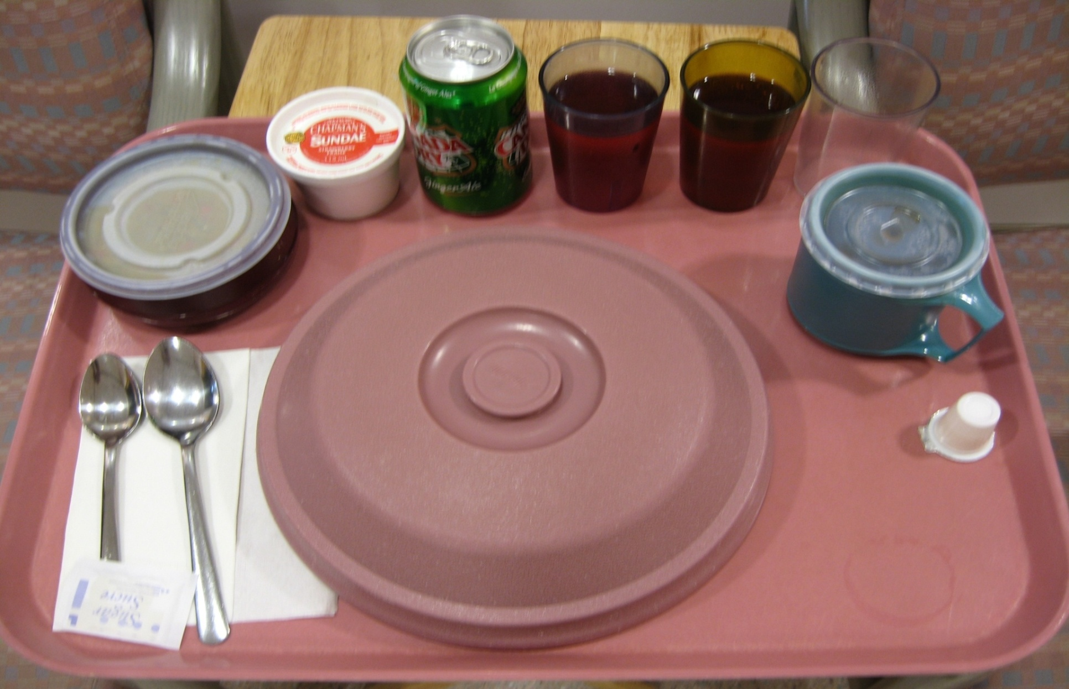
Could a 80 year old senior can eat all of this?
Institutional looking!

Slide 34
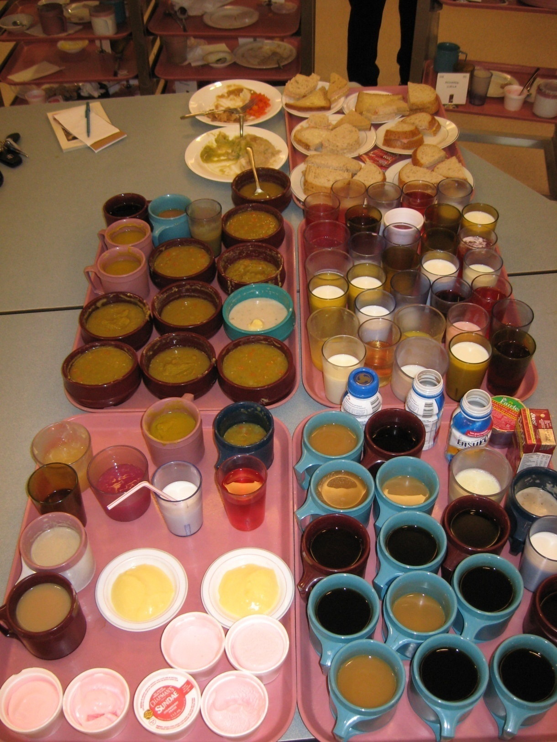
After 42 trays…
7 full sandwiches
10 bowls + 7 mugs of soup
6 ice cream cups
2 puddings
17 mugs of tea/coffee
8 supplements
12 glasses milk
7 thick fluids
16 glasses of juice
~$30.00
150 residents x 3 meals/day
x 365 days/year =
$110,000 per year in wasted food

Slide 35

Tray Service Generates More Food Waste in Dining Areas of a Continuing-Care Retirement Community
Applications :
Changing the style of service can affect not only quantity of solid waste generated and associated disposal costs but also food and supply costs, meal acceptability, and quantity of natural resources required. The systems approach should be used to assess the feasibility of changing service system so that all costs are considered.

Slide 36
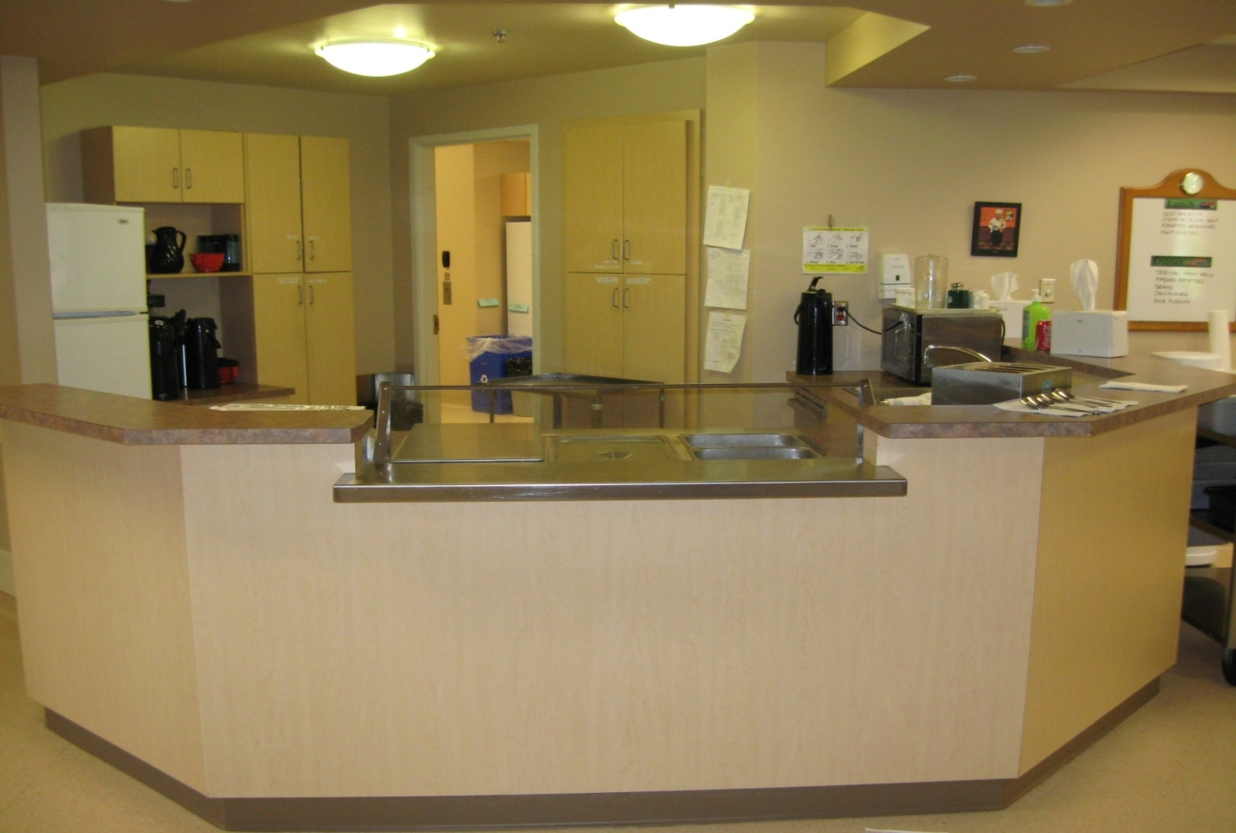

#2) Typical “severy” System
(neighborhoods, pass thru, window service, pre-plate)
Dull, boring, & high food waste

Slide 37
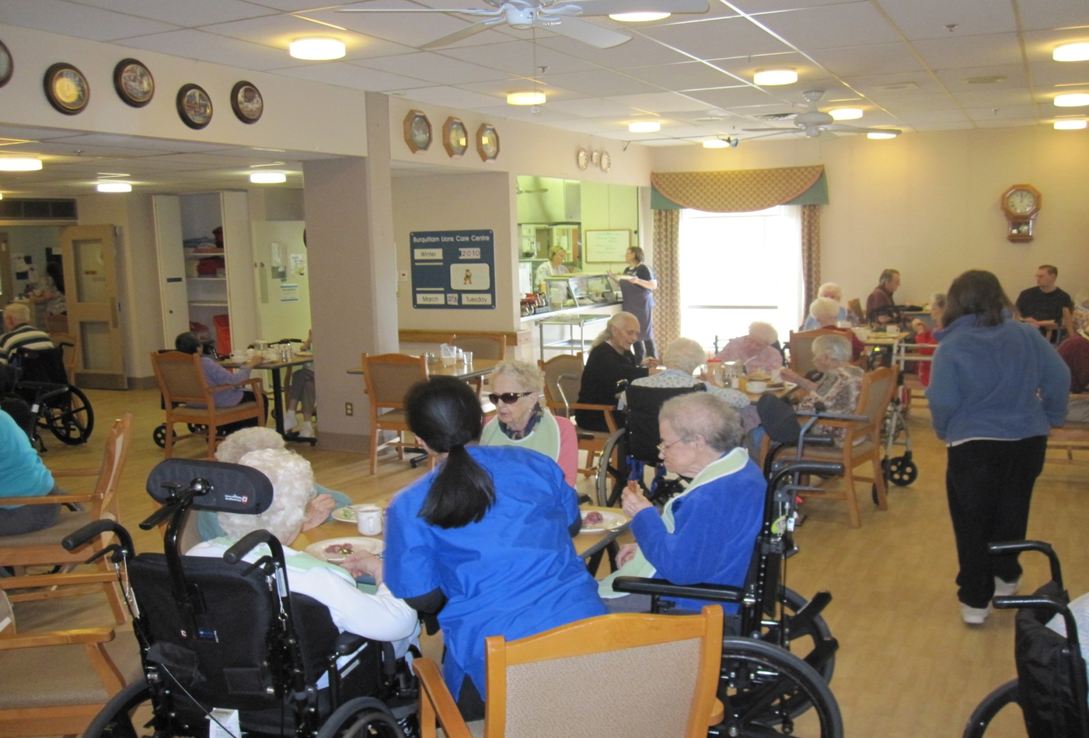
Typical situation - Cook behind the steam table, and staff pick up
pre-plated meals – lots of lists, running back & forth, limited contact
“Throw & Go” method

Slide 38
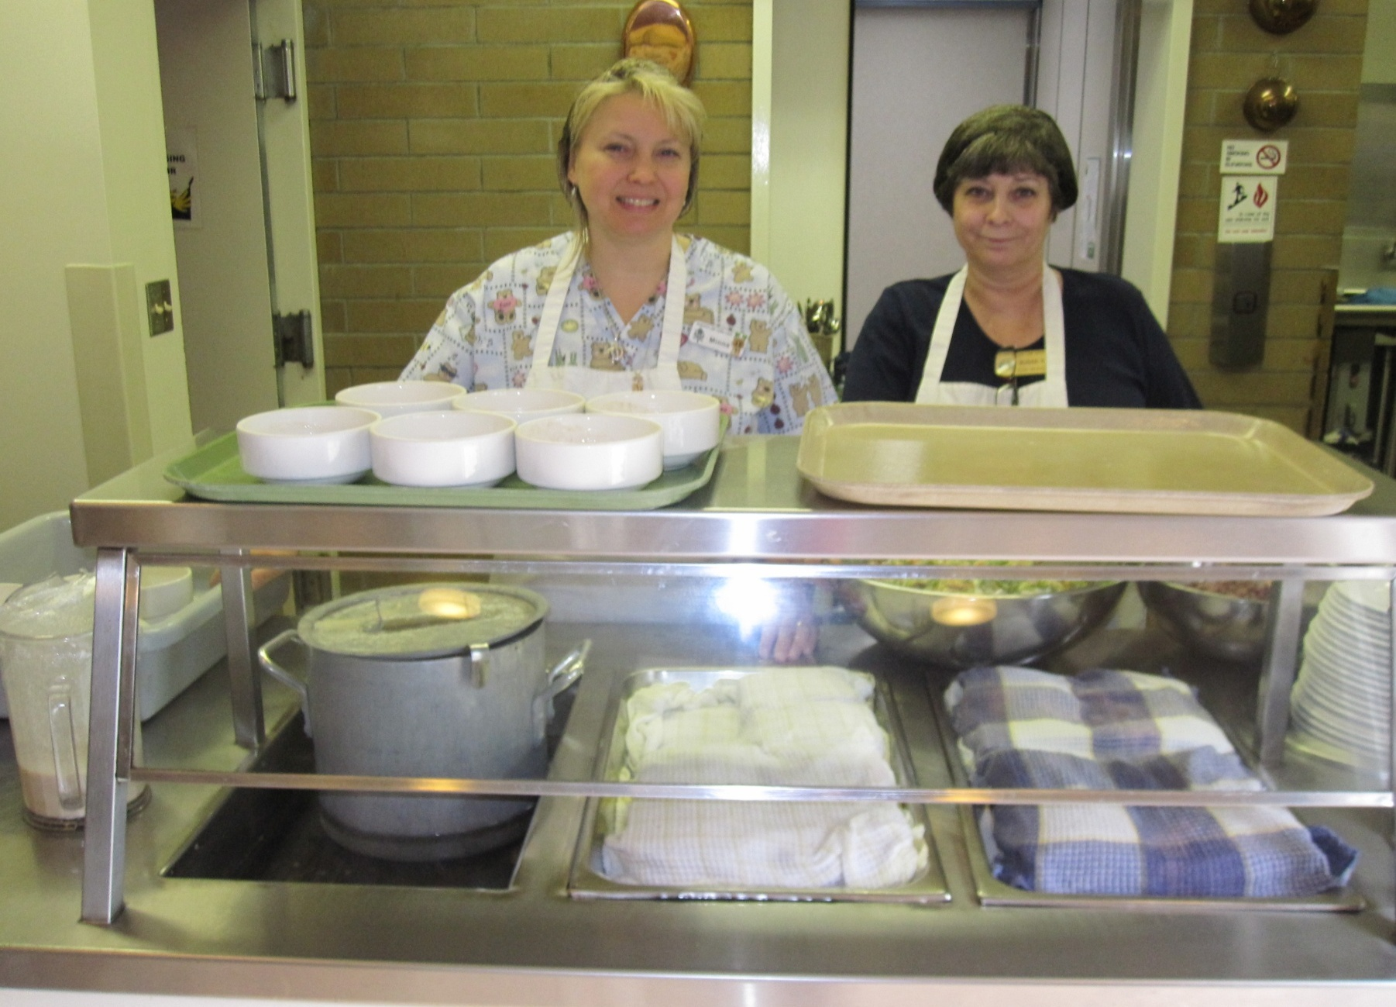
Cook & aid stuck behind a table, reading long lists
(no interaction with their customer)

Slide 39
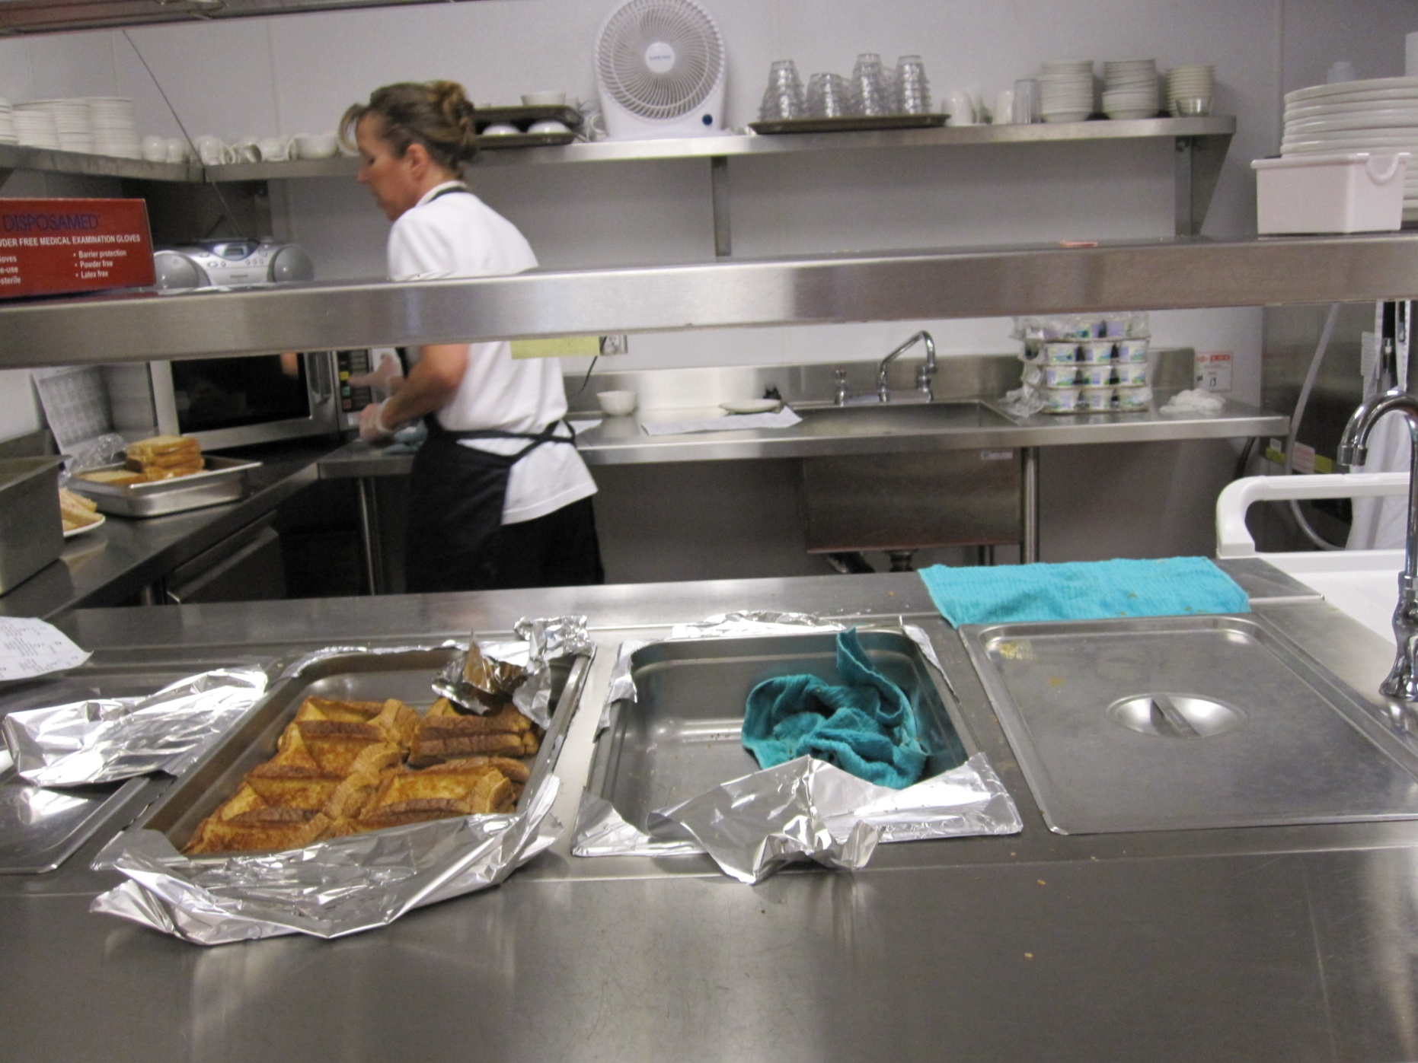
FS worker in the back of satellite kitchen up for 50+ resident DR

Slide 40
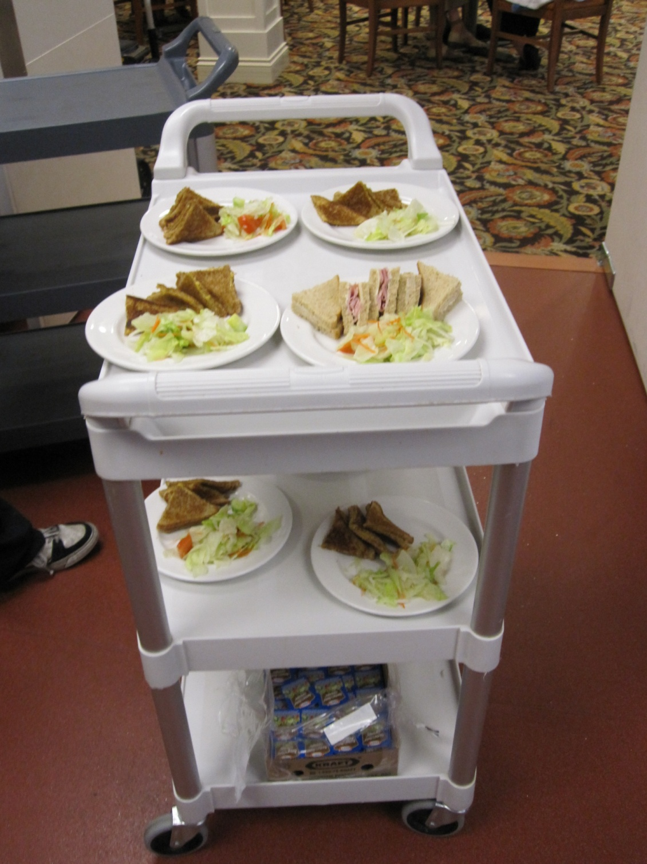
This is
PRE-determined,
not
SELF-determined!
There’s a
MAJOR
difference!

Slide 41
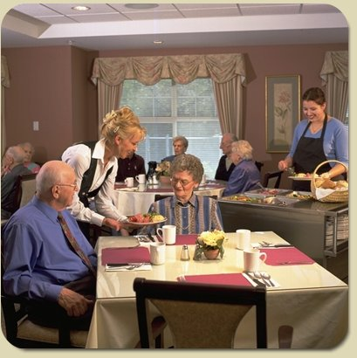
#3) Direct Dining (self determined)
Residents are stationary
All food/drink is mobile
Similar to “Dim Sum”
Lots of choice within menu
Staff work as a team
Flexibility
Saves money, hotter food
“It’s a Resident’s Choice!”

Slide 42


Instead of “The Dining Room Run”
(or tray line) + reading long lists…
go bulk mobile and spend that time
talking to the residents.
Goal: get as close as you can with food to
give folks a daily chance to talk
“Creating an experience that people can remember,
not just creating a room where people eat”
Cheryl Lucas, consultant to LTC

Slide 43
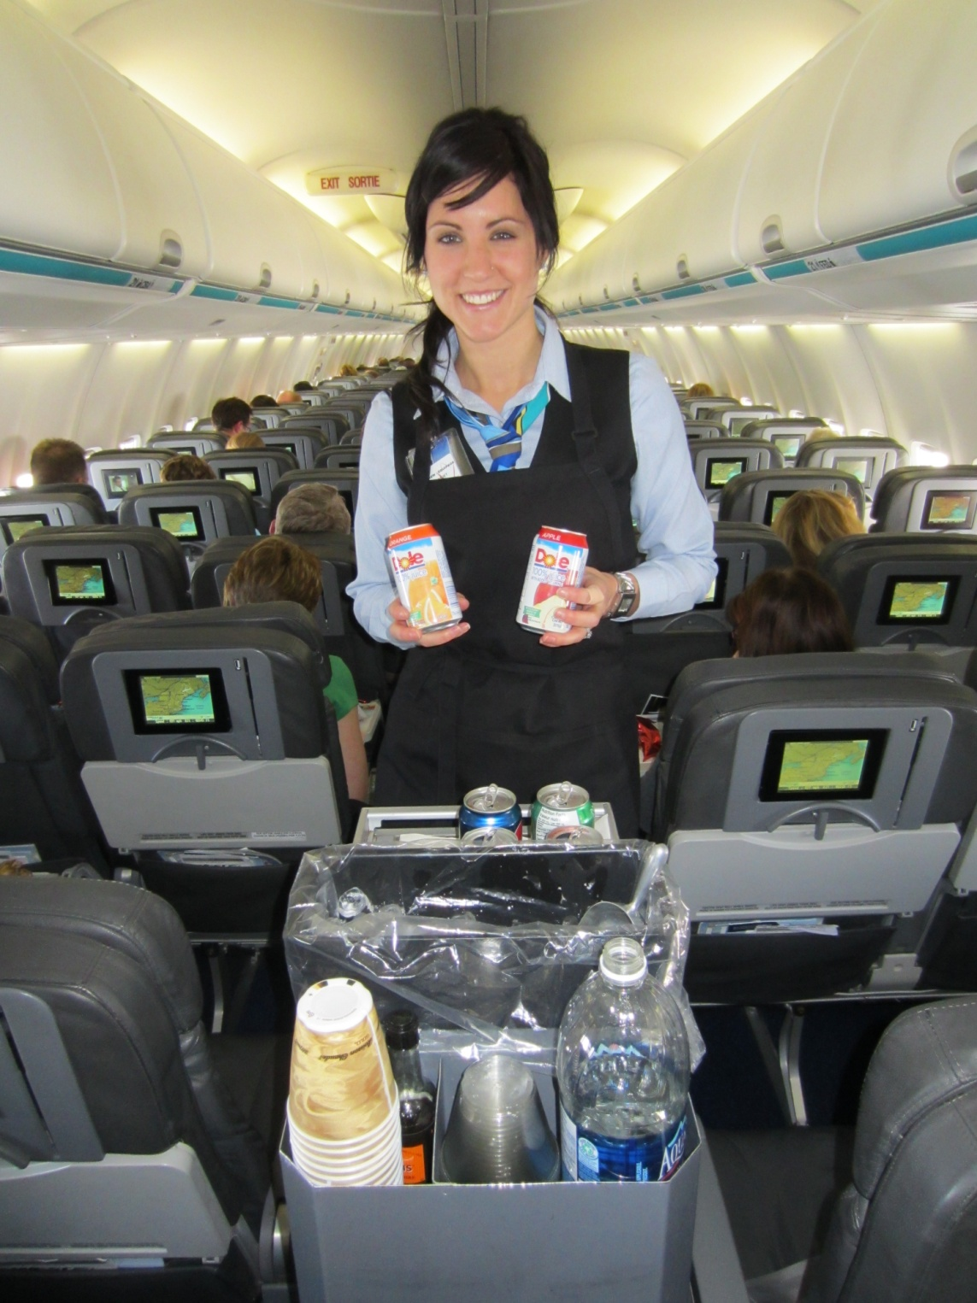
Similar to being on a plane & receiving beverage service…
(kind of fun, choices!)

Slide 44
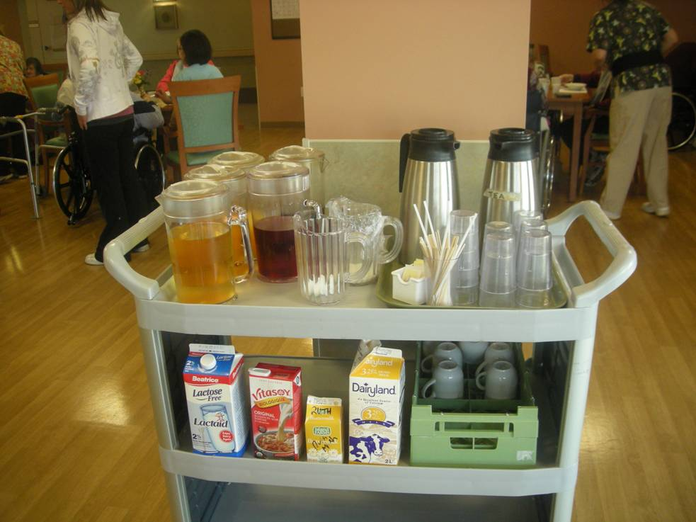
Beverage Cart
Support Staff
Before & during meals
Re-fills offered!
Hot & cold drinks
1 cart per Dining Room
Less waste = save $$
No more pre-poured juice or milk
Idea: Cue cards on “what” and “how to serve?

Slide 45
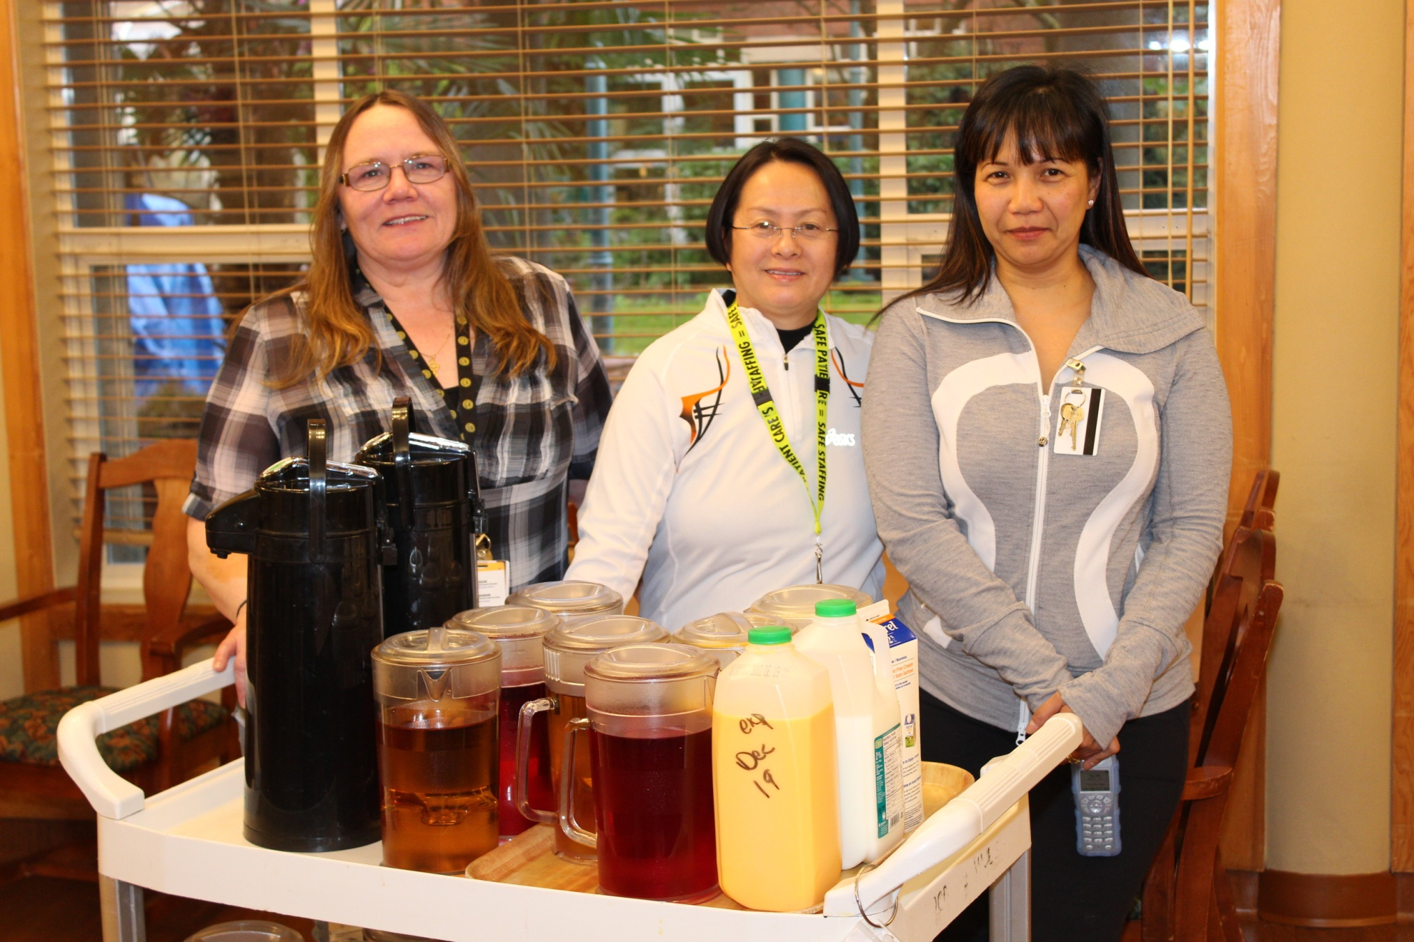
Q: How many beverage option to you offer daily? Do you waste $?

Slide 46
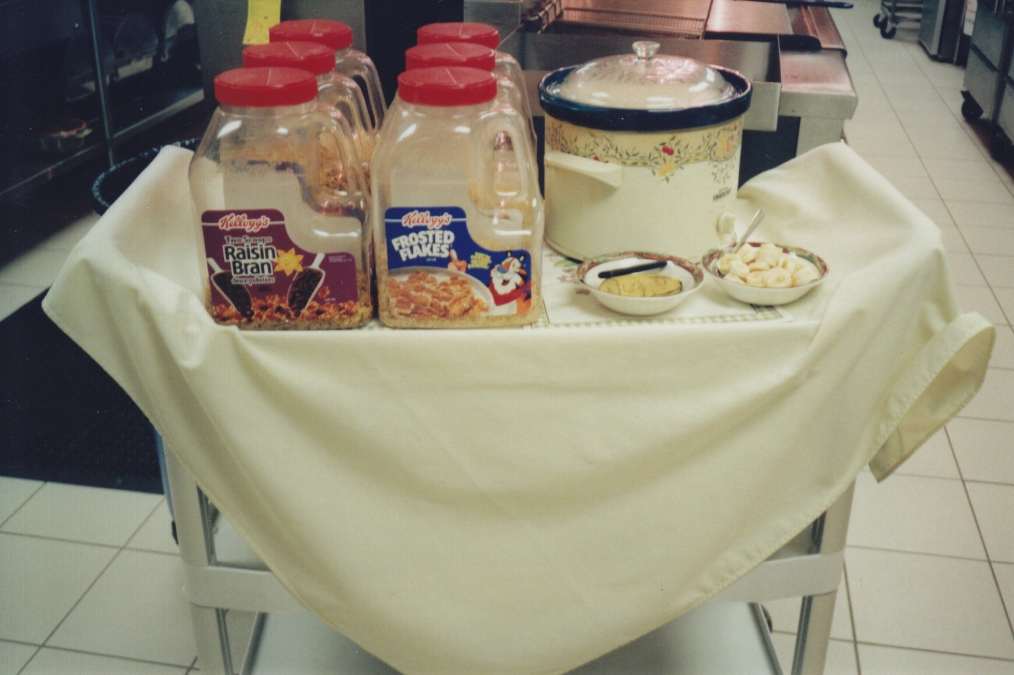
6 cold cereals + 1 Hot cereal + bananas offered daily = variety!
Q: How many cereal choice do you offer daily?

Slide 47
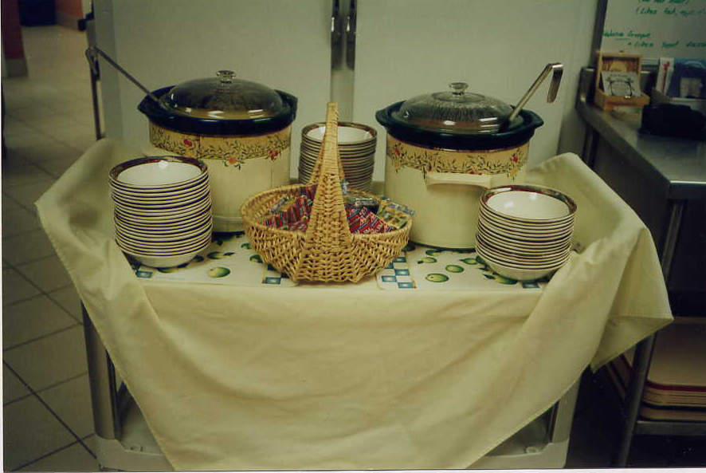
Soup Cart

Slide 48
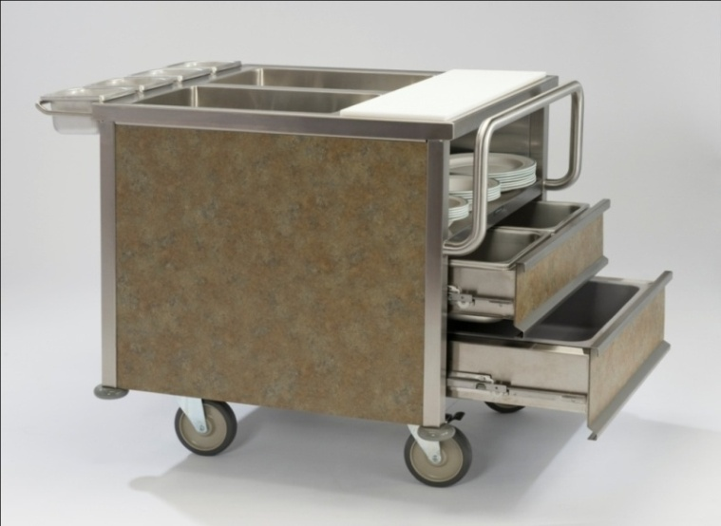
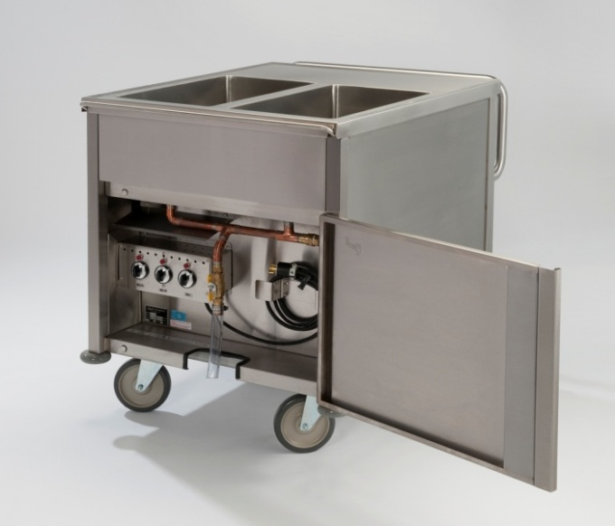
Mobile cart (i.e. SuzyQ) Russell Food Equipment
Compact (32” wide)
2 separate wells & dials
Plate warming shelf = dial
Ergonomic handle
Pull out condiment rail
6” directional lock castors (1000 lbs)
1 cart ~ up to 40+ residents
R.O.I = first year savings!
Food waste reduction = 30% +

Slide 49
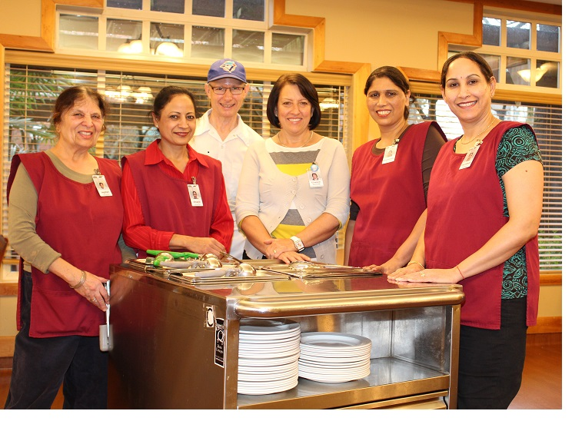
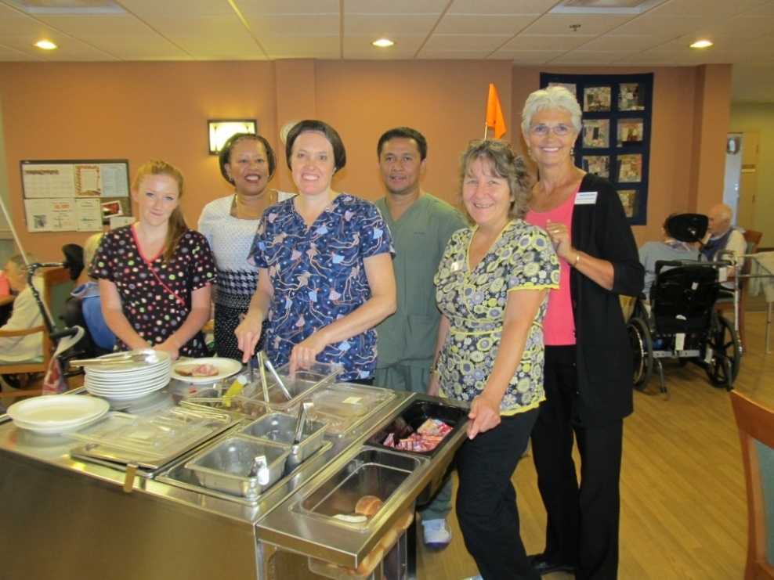
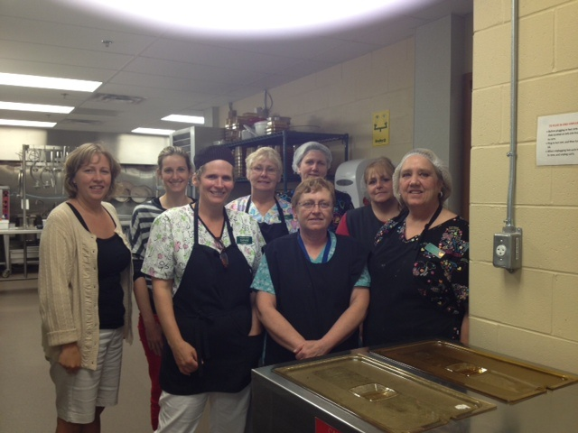
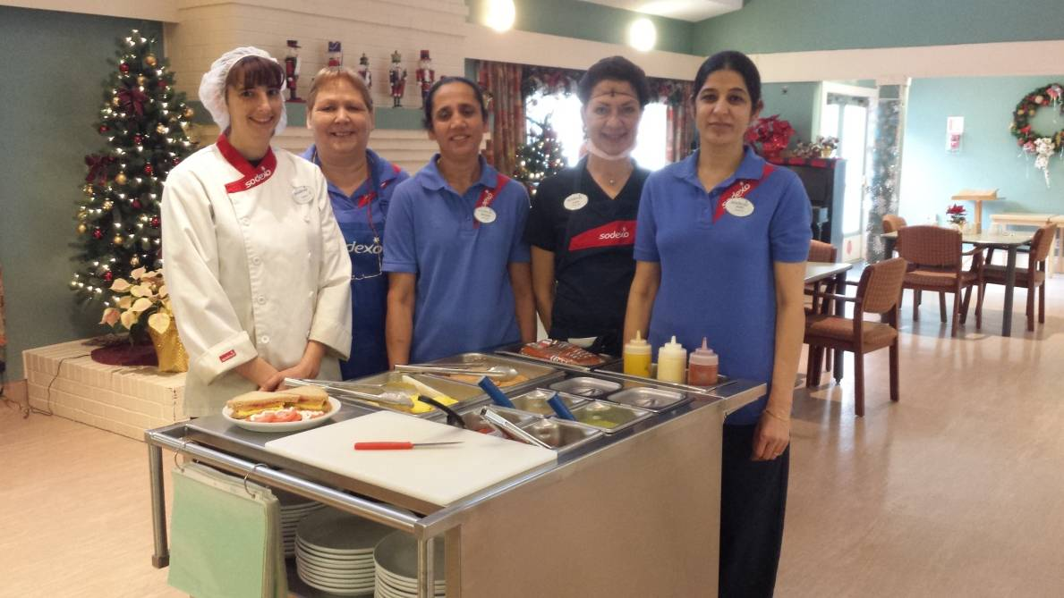
400+ care facilities using this style

Slide 50
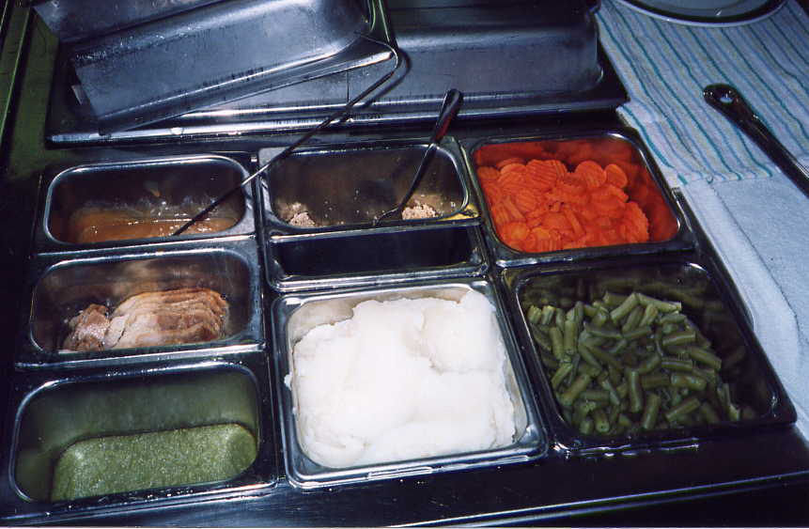
One side of the cart = 1 full size insert
(puree, minced, chopped, regular)

Slide 51
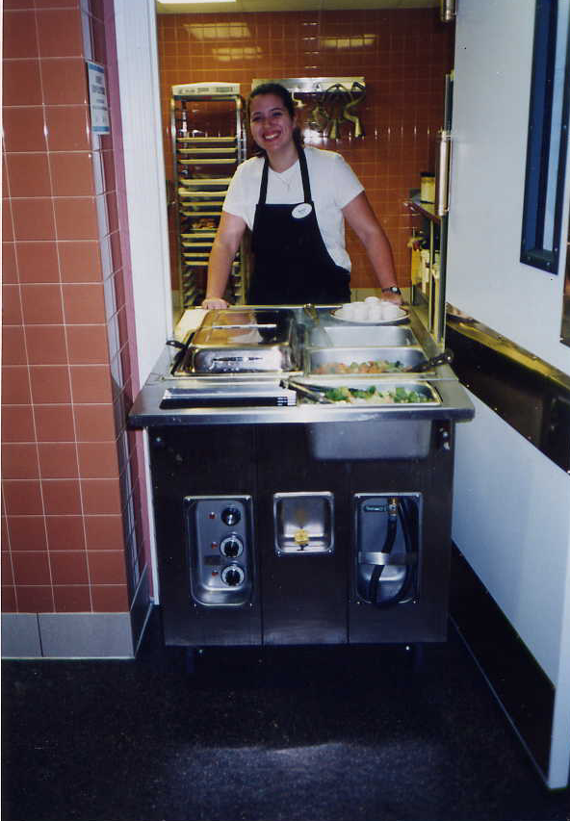
Dietary Aid leaving “the 4 walls of
the kitchen”
to interact and serve!
Major benefits!

Slide 52
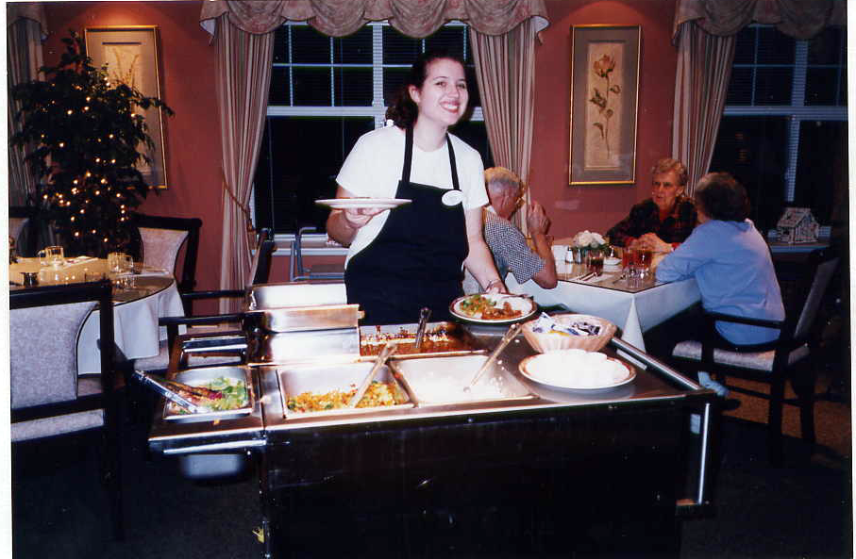
Serving directly in the Assisted Living Dining room

Slide 53

Eye contact. Talking to the resident first. No running. Personal.

Slide 54

Introducing
the menu to the residents first,
before
plating up…

Slide 55

Then plate up accordingly. Don’t assume. Always ask first.

Slide 56

Bulk condiments save money, and easier for residents too!

Slide 57

Showing residents with dementia their meal choices is helpful
when words are hard for them

Slide 58

Dessert Cart
Support staff
Lunch & Supper
Choice of desserts
Fruit bowl
Excellent leftover use
“whip cream” story
Benefit #3: They choose what to eat & quantity
“I love having my choice, especially dessert” (David, 79)

Slide 59

An idea!
Save money by putting supplements on the dessert cart
Fill up on
REAL FOOD FIRST
vs
$ supplements

Slide 60
Idea:
Let’s not serve food/drinks that residents don’t want = $$ saving!
Leftovers
Great way to use leftovers that aren’t dished or plated out ($$)
Leftover muffins from bfst = coffee corner
Leftover sandwiches at lunch = nourishment snack
Leftover corn from supper = goes into tomorrow’s soup
Variety of desserts (leftover desserts)
No pre-poured juice
Licensing
provide and offer based on CFG….but ASK the residents first, serve if they want it

Slide 61
Helpful “Culture Change” resources
www.pioneernetwork.net (BEST!)
*New Dining Standards & tool kit *
www.actionpact.com = “Changing communities, changing lives”
www.changeculturenow.com
www.ChangingAging.org
www.edenalt.com

Slide 62




Please print off the Dining Standards…
read it, share it, teach staff with it.
This is your document for change in the dining room.
www.pioneernetwork.net
Website looks like this
My copy

Slide 63

Some examples...

Slide 64


Slide 65


Slide 66

Food easily transported to each dining room & served.

Slide 67

Self – determination….not pre-determiation for them = Respect!

Slide 68


Slide 69


Slide 70


Slide 71

Menu side of cart
Comfort food side of cart

Slide 72


Slide 73


Slide 74


Slide 75


“just mashed potatoes with
lots of gravy” please…

Slide 76


Benefits to Dietary Staff
Save a TON of money in less food waste
Personally get to know the residents
No long “likes/dislikes lists” to read
Time saved can be used more wisely
Residents eat better = gain weight
No pre-portioning of drinks, cereal, desserts
Go “green” with bulk service (less packaging)

Slide 77

Last thoughts....
Mgmt Team serve coffee daily (weekly schedule)
Just sit and watch for 45 minutes – what did you learn?
Start a monthly inter-disciplinary Food Committee
Clearly define & post everyone’s job/timing in the DR
Socialization is a key part of DR activity – 60% of their day! Protect this time
Do a waste audit (it takes about 45 minutes). Invaluable!
Marketing your meals = higher satisfaction = residents stay
“This meal service is more sane than the other home I was at”

Slide 78



Implementation support
Staff training manual
Live free weekly webinar classes (idea: lunch & learn?)
Email suzyq@hotfoodcart.com
Phone support (1-877-456-8219 PST)
Quarterly e-newsletter
www.hotfoodcart.com
I’m here for you to be successful!

Slide 79

Question & Answer time
“Choice of food has a tremendous impact on quality of life.
Some might say it defines quality of life”
Pioneer Network Dining Standards

